Slide 1

Student Management Using B+ Tree

Slide 2
Table Of Contents
Introduction to B+ trees
Searching on B+ trees
Insertion on B+ trees
Deletion on B+ trees
References

Slide 3
Data Structures Used
B PLUS TREE - A B+ tree is a balanced tree data structure that is commonly used for indexing and organizing large amounts of data. It is an extension of the B-tree and is specifically designed for efficient disk-based storage systems.
Using Queues

Slide 4
Benefits and Advantages :
Hierarchical organization of data
Efficient search, insertion, and deletion operations
Dynamic and adaptable to changes in data
Advantages of B+ trees for database indexing:
Optimized for disk-based storage, minimizing disk I/O
Supports range queries efficiently
Easier to maintain balance and minimize tree height

Slide 5
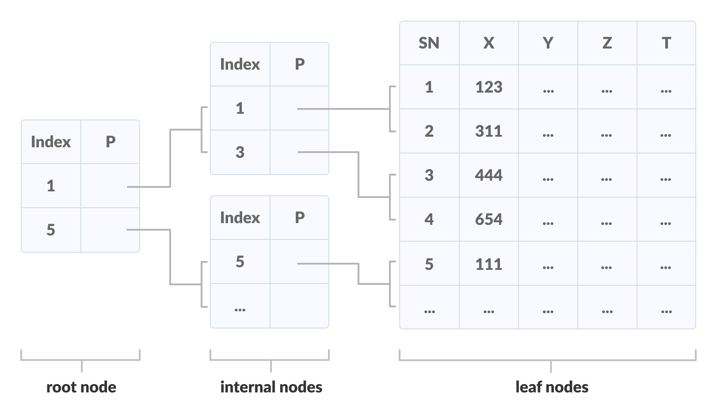
Introduction to B+ Tree
A B+ tree is an advanced form of a self-balancing tree in which all the values are present in the leaf level.
An important concept to be understood before learning B+ tree is multilevel indexing. In multilevel indexing, the index of indices is created as in figure below. It makes accessing the data easier and faster.

Slide 6
Introduction to B+ Tree
Properties of a B+ Tree
All leaves are at the same level.
The root has at least two children.
Each node except root can have a maximum of m children and at least m/2 children.
Each node can contain a maximum of m - 1 keys and a minimum of ⌈m/2⌉ - 1 keys.

Slide 7
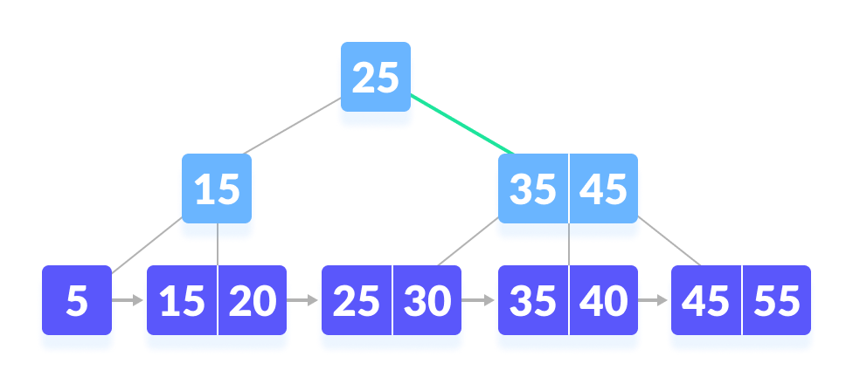
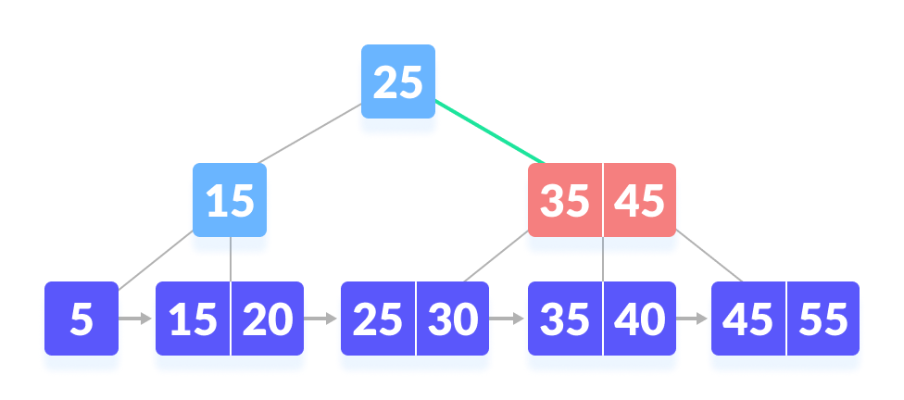
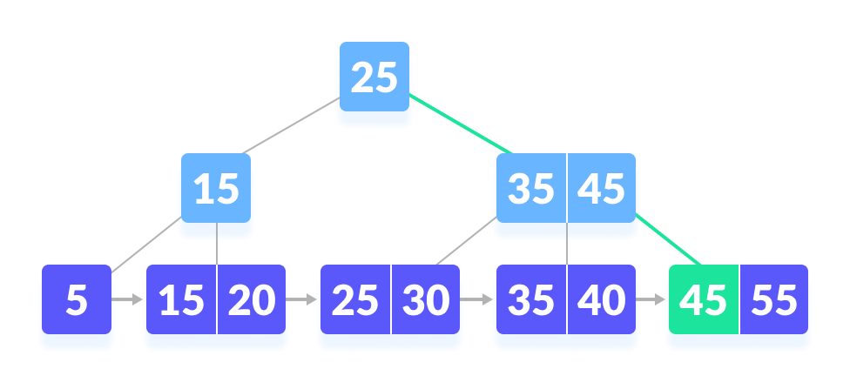
Searching on B+ Tree
E.g. Let us search k = 45 on the following B+ tree.

Slide 8
Insertion on a B+ Tree
Case I
If the leaf is not full, insert the key into the leaf node in increasing order.
Case II
If the leaf is full, insert the key into the leaf node in increasing order and balance the tree in the following way.

Slide 9

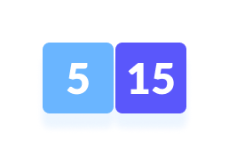
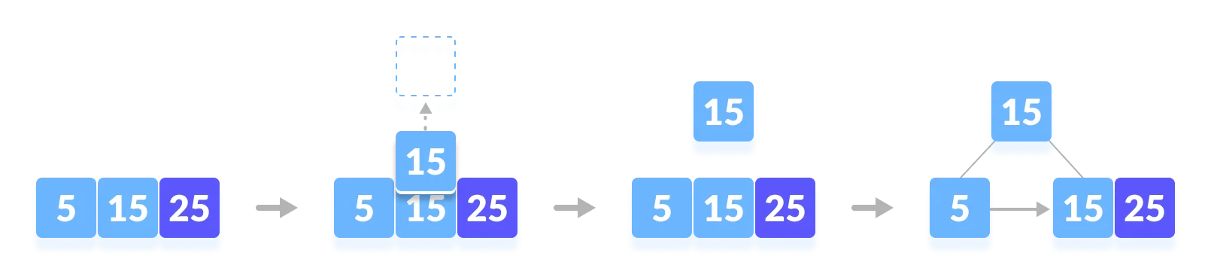
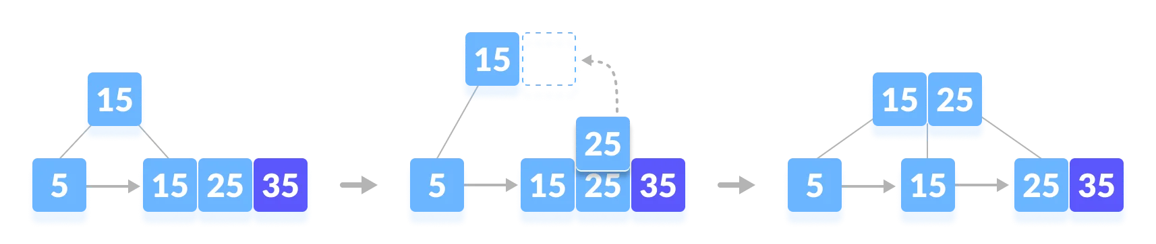
Insertion on a B+ Tree
1
Let's see how insertion works by inseting elements in tree e,g => 5,15, 25, 35, 45.
Insert 5 2. Insert 15
3. Insert 25
4. Insert 35

Slide 10
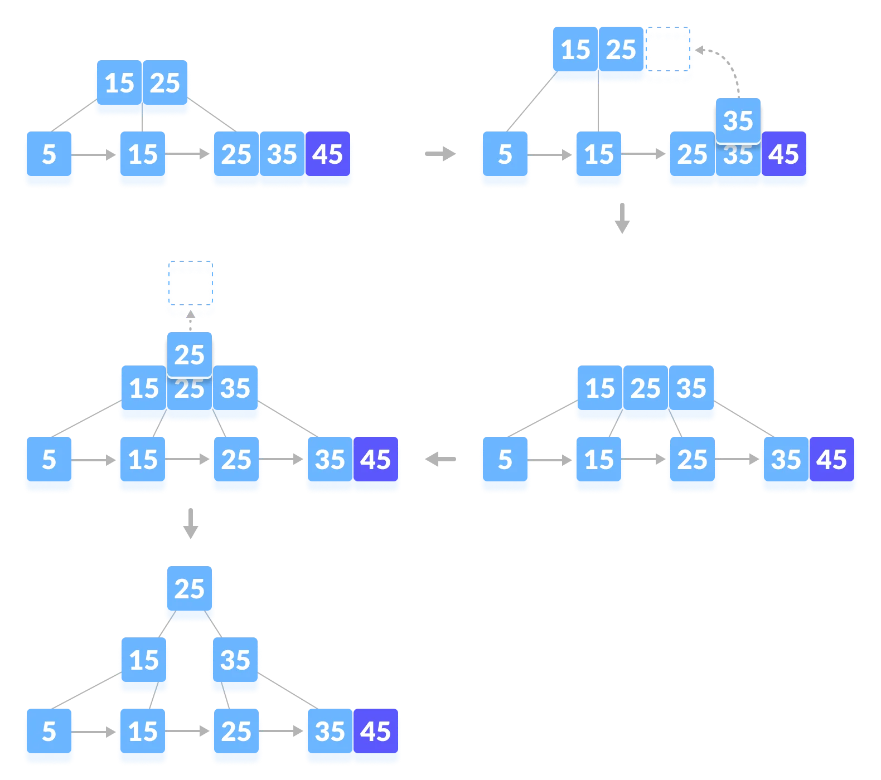
Insertion on a B+ Tree
5. Insert 45

Slide 11
Deletion in B+ tree
While deleting a key, we have to take care of the keys present in the internal nodes (i.e. indexes) as well because the values are redundant in a B+ tree.

Slide 12
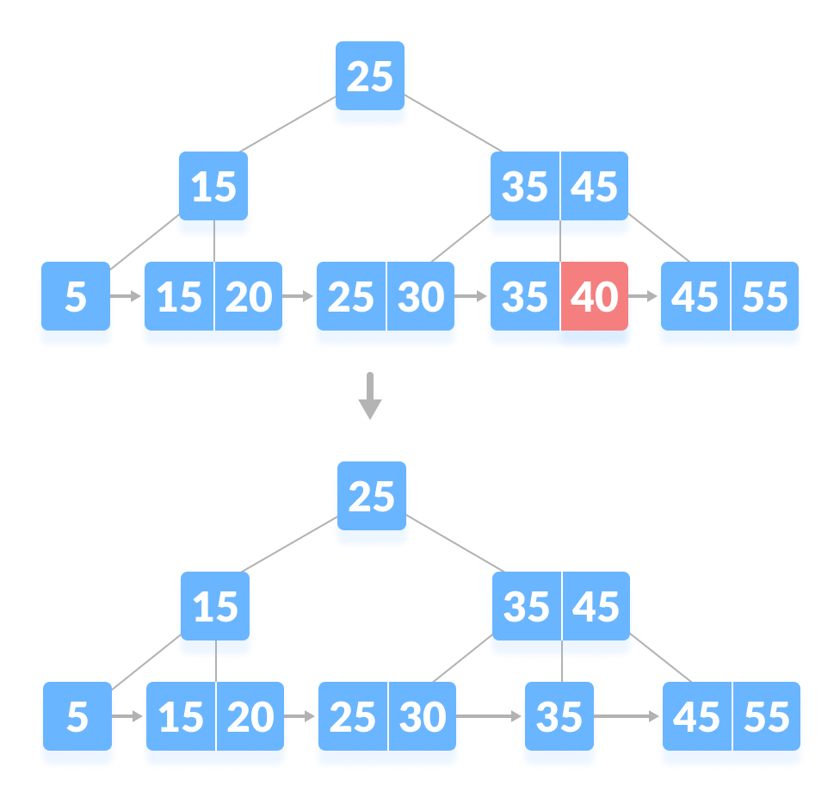
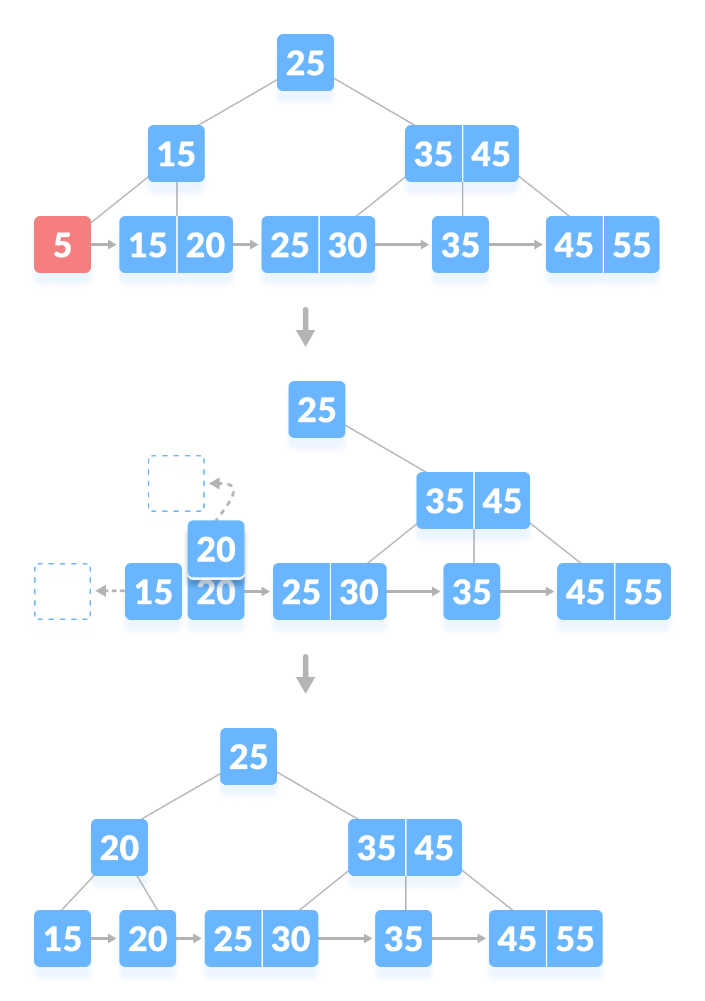
Deletion in B+ tree
1
Case I
The key to be deleted is present only at the leaf node not in the indexes (or internal nodes). There are two cases for it:
There is more than the minimum number of keys in the node. Simply delete the key.
There is an exact minimum number of keys in the node. Delete the key and borrow a key from the immediate sibling. Add the median key of the sibling node to the parent.

Slide 13
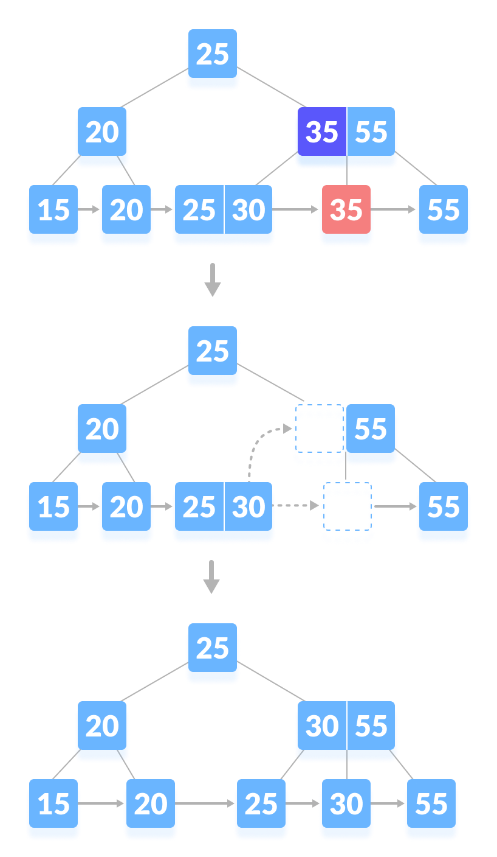
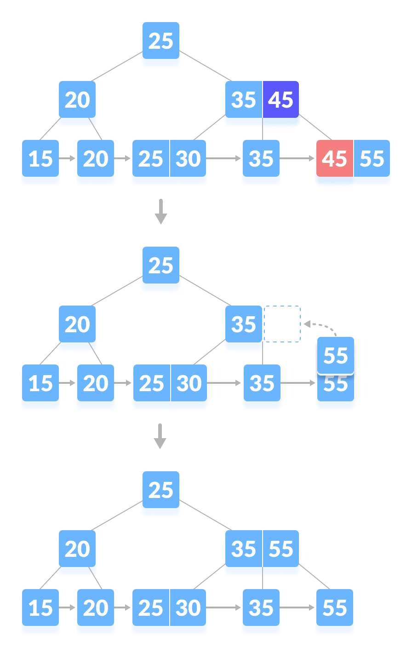
Deletion in B+ tree
2
Case II
The key to be deleted is present in the internal nodes as well. Then we have to remove them from the internal nodes as well. There are the following cases for this situation.
If there is more than the minimum number of keys in the node, simply delete the key from leaf node and delete the key from the internal node as well. Fill the empty space in the internal node with the inorder successor.
If there is an exact minimum number of keys in node, then delete the key and borrow a key from its immediate sibling (through parent).Fill the empty space created in index (internal node) with the borrowed key.

Slide 14
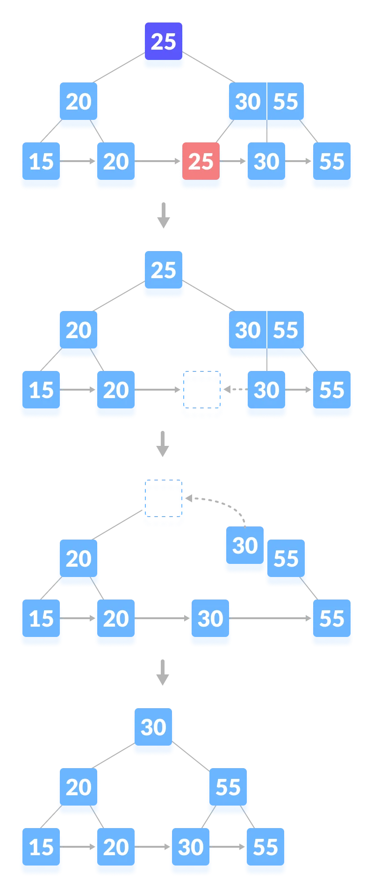
Deletion in B+ tree
2
Case II
The key to be deleted is present in the internal nodes as well. Then we have to remove them from the internal nodes as well. There are the following cases for this situation.
This case is similar to Case II(1) but here, empty space is generated above the immediate parent node. After deleting the key, merge the empty space with its sibling. Fill the empty space in the grandparent node with the inorder successor.

Slide 15
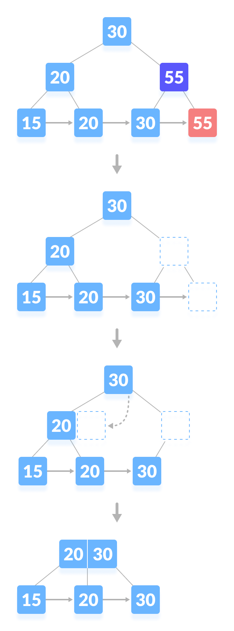
Deletion in B+ tree
3
Case III
In this case, the height of the tree gets shrinked.
It is a little complicated. Deleting 55 from the tree below leads to
this condition. It can be understood in the illustrations below.

Slide 16
Atharv Gosavi
Ashmit Nagdive
Atharva Joshi
Rohan Ghatol
THANK
YOU!!!

